Slide 1



Slide 2
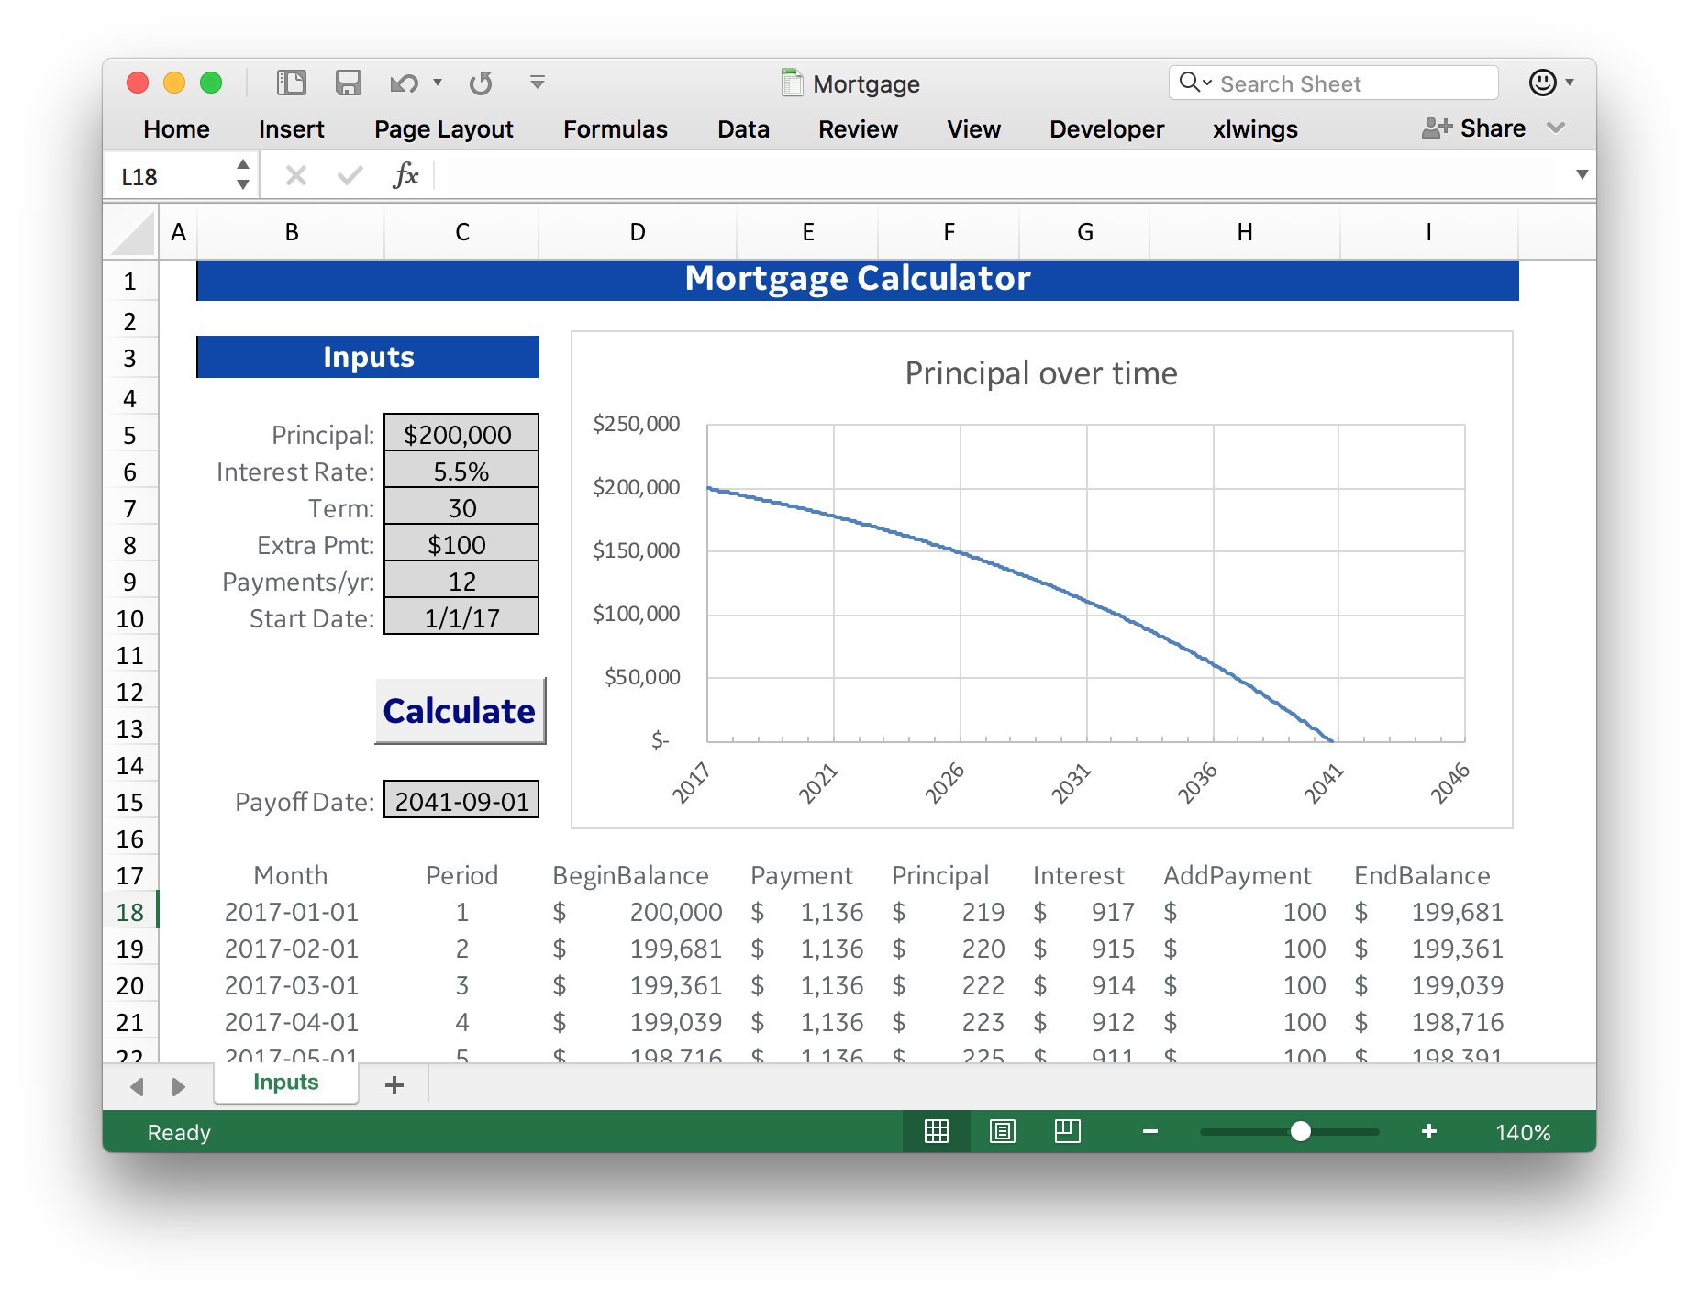
Excel chart
Inputs
Macro
Outputs

